Slide 1

Tour And Travels
NIET NOIDA

Slide 2
Institute Name: NOIDA INSTITUTE OF ENGINEERING AND TECHNOLOGY
Submitted By :
Abhishek Kumar Verma
Abhishek Raj
Aditya Verma
Submissions Date : 05/05/2023

Slide 3
Project Contains
Project Specification
Introduction
SDLC
Data Flow Diagram
E-R Diagram
Data Dictionary
Screen Layout
Limitations
Bibliography
Future Enhancements

Slide 4
Project Specifications
Project Title : Tour And Travels Institution : College Of NIET Computer Science Front End Tools : HTML , CSS , JAVASCRIPT , PHP Back End Tool : MY SQL Documentation Tool : MS word Operating System : Microsoft windows 7-11 Web Server : Wamp Web Browser : chrome Editor : Visual studio Hardware : 32,64-bit processor, 1.70 GHz, RAM : 2GB Submitted By : NIET NOIDA

Slide 5
Introductions
The Tour and Travels is a web based application.
The main purpose of “Tour and travels”
is to provide a convenient way for a customer
to book hotels, flight, train and bus for tour purposes

Slide 6
System Development Strategy
As per the requirement of the project, We have choose
the Spiral as a strategy of developing the project, because
in Spiral-SDLC model starts with a small set of requirement
and goes through each development phase for those set of
requirements, so the appropriate strategy is spiral model.

Slide 7
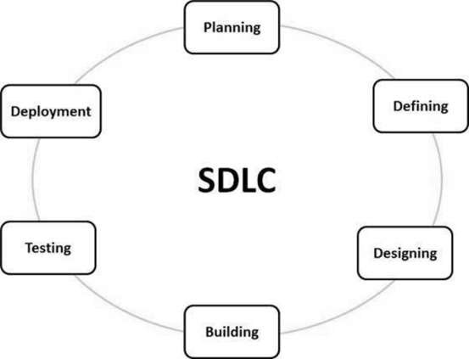

Slide 8
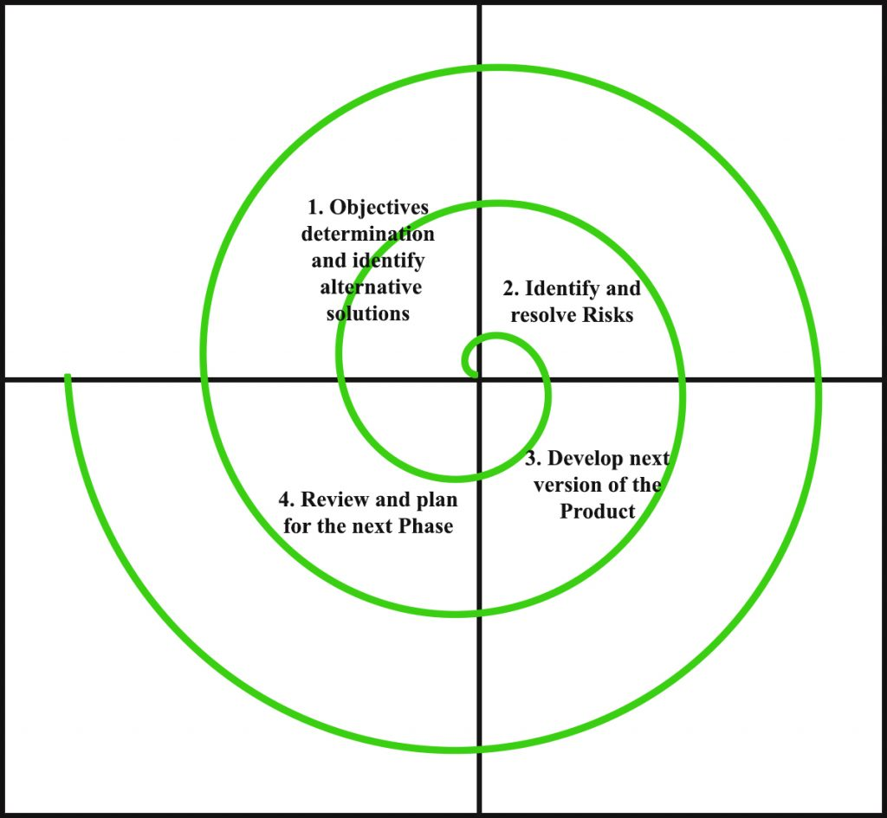
Spiral Module

Slide 9
Modules
User Authority :
Home menu
About us
Gallery
Booking
Videos
Login
Registration
Change Password

Slide 10
Admin Authority :
Home menu
User Data
Booking Data
Feedback
Change Password
Logout

Slide 11
System Design
ER Diagram
DFD
Data Dictionary
Screenshots- Design

Slide 12
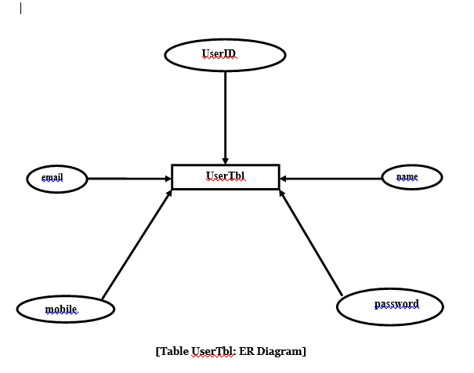
ER Diagram :UserTbl

Slide 13
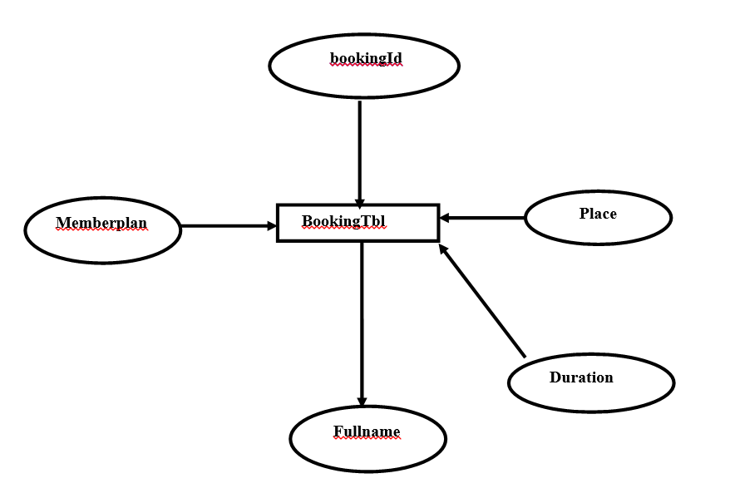
ER Diagram :BookingTbl

Slide 14
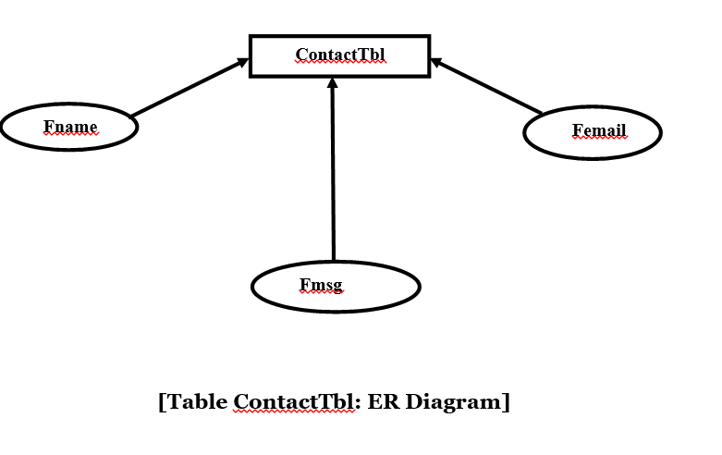
ER Diagram :ContactTbl

Slide 15
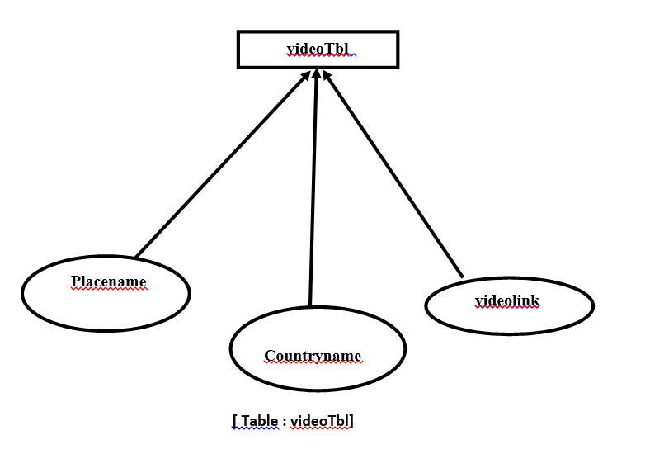
ER Diagram : videoTbl

Slide 16
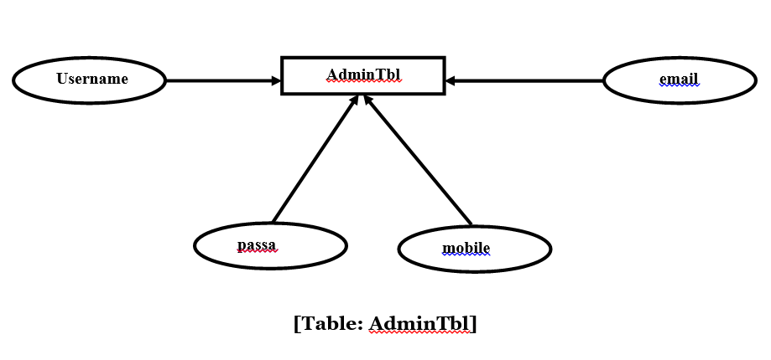
ER Diagram : AdminTbl

Slide 17
Data Flow Diagram
A data-flow diagram (DFD) is a graphical representation of the "flow" of data through an information system. DFDs can also be used for the visualization of data processing (structured design).
On a DFD, data items flow from an external data source or an internal data store to an internal data store or an external data sink, via an internal process.

Slide 18
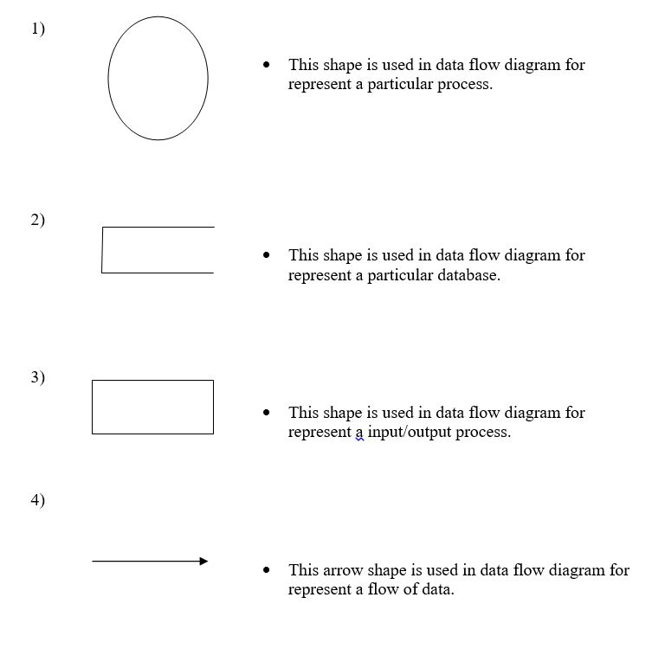

Slide 19
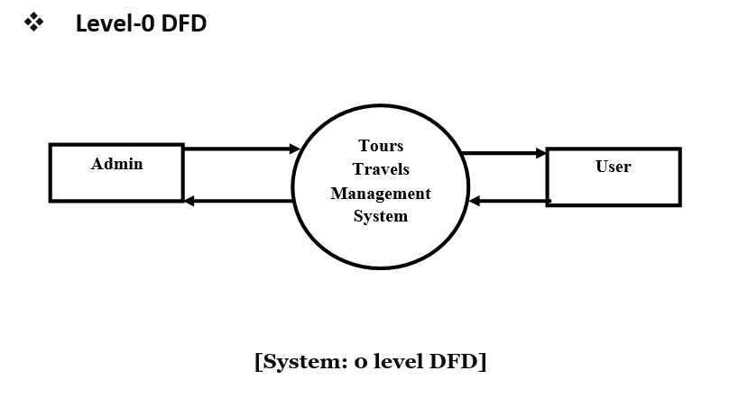

Slide 20
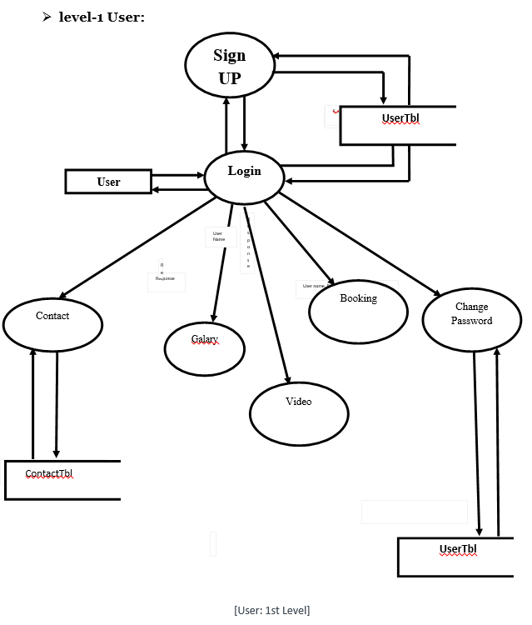

Slide 21
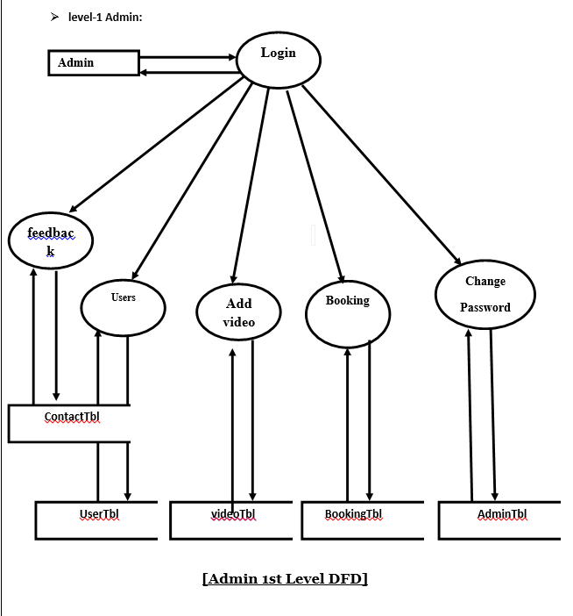

Slide 22
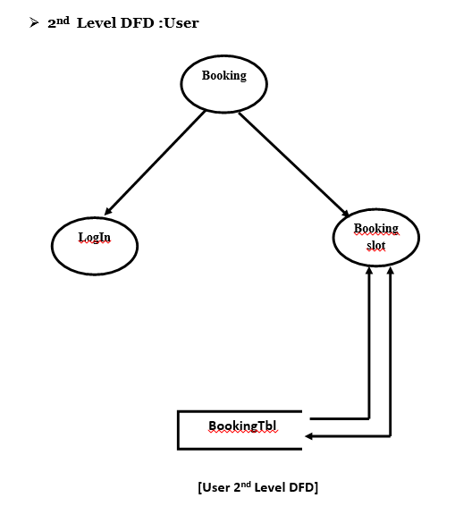

Slide 23
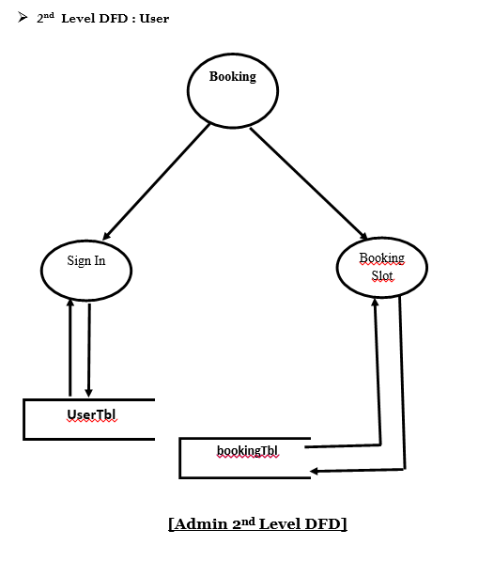

Slide 24
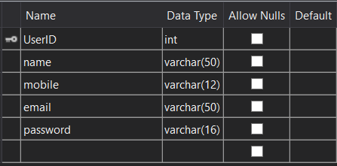
Data Dictionary
Table 1: UserTbl

Slide 25
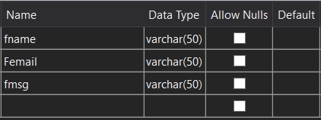
Table 2: ContactTbl

Slide 26
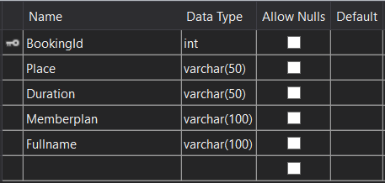
Table 3: BookingTbl

Slide 27
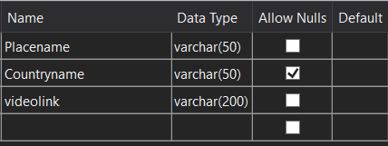
Table 4: videoTbl

Slide 28
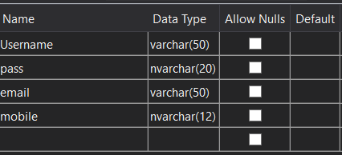
Table 5: AdminTbl

Slide 29
Project Screenshot

Slide 30
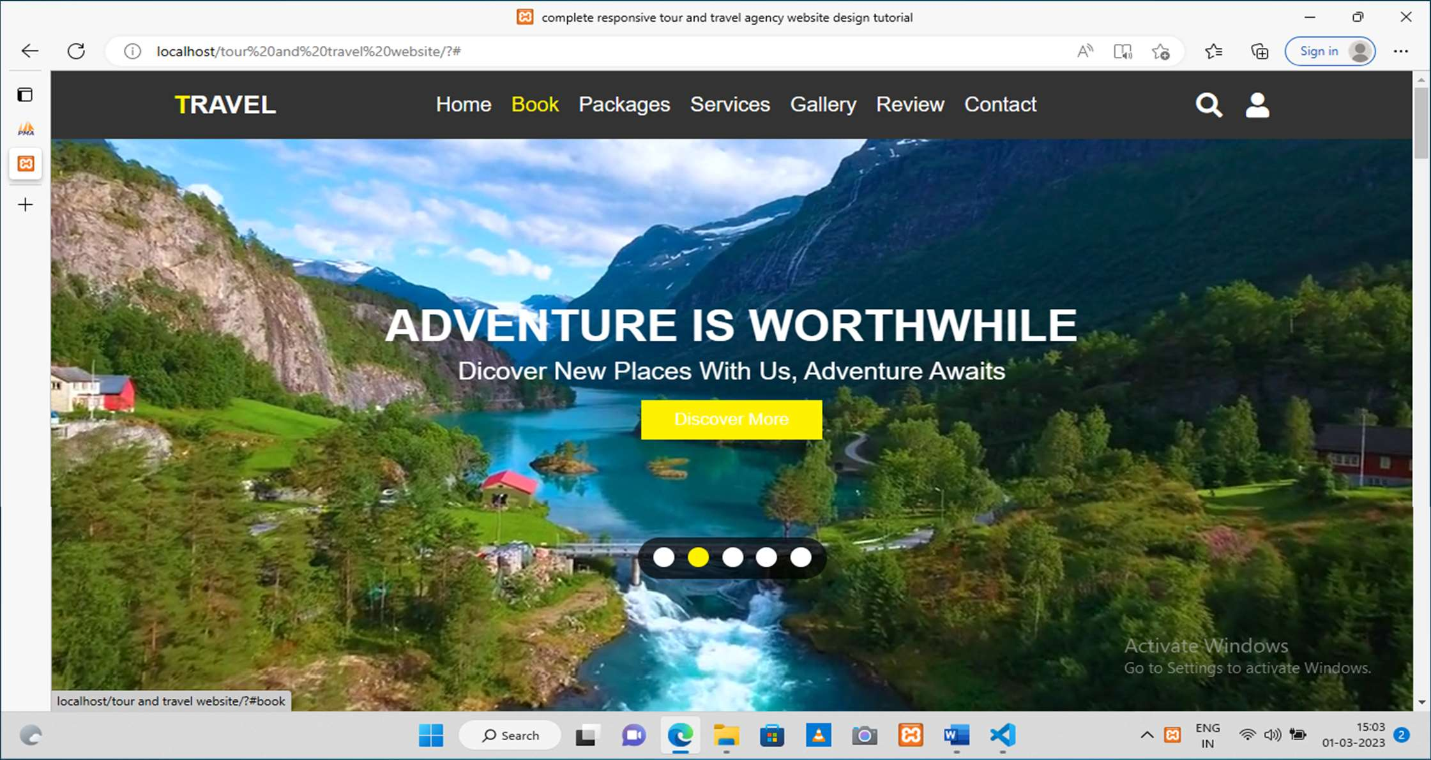

Slide 31
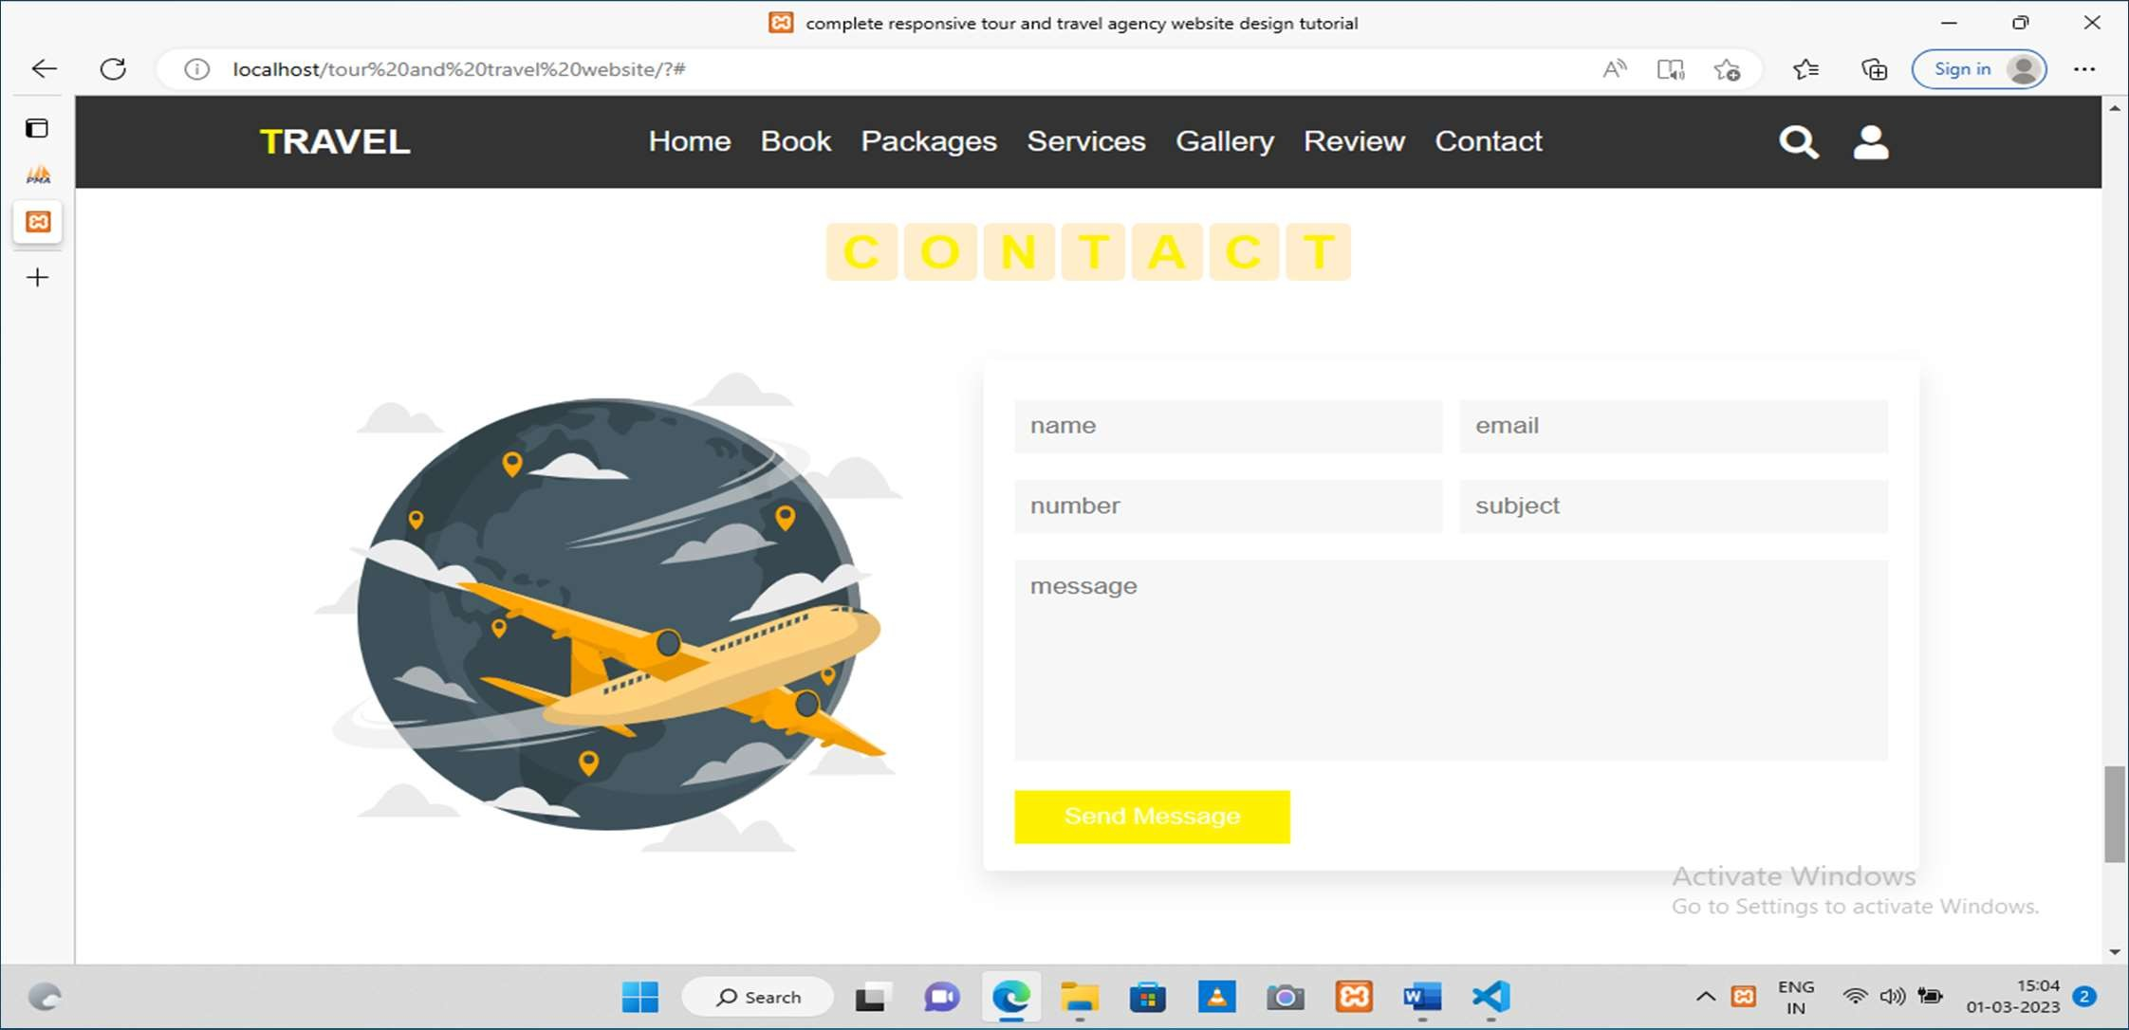

Slide 32
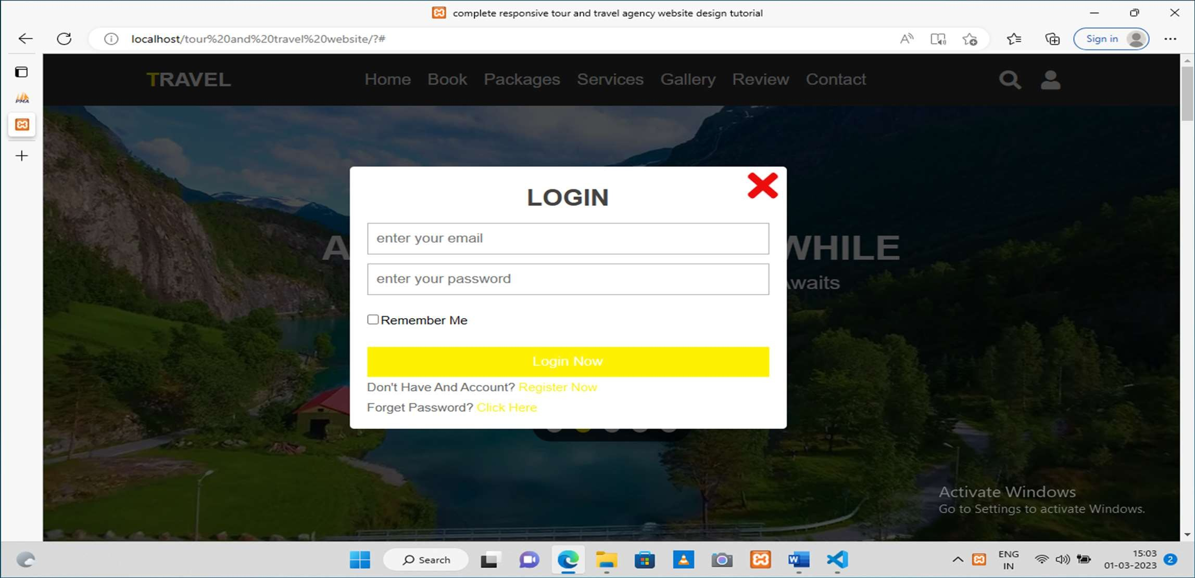

Slide 33
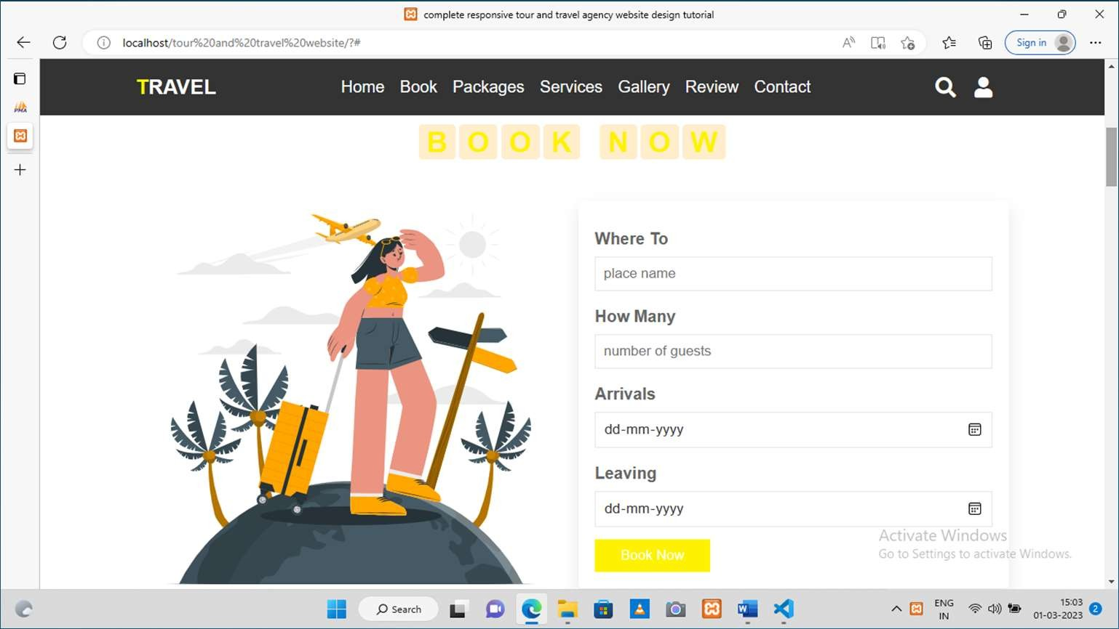

Slide 34
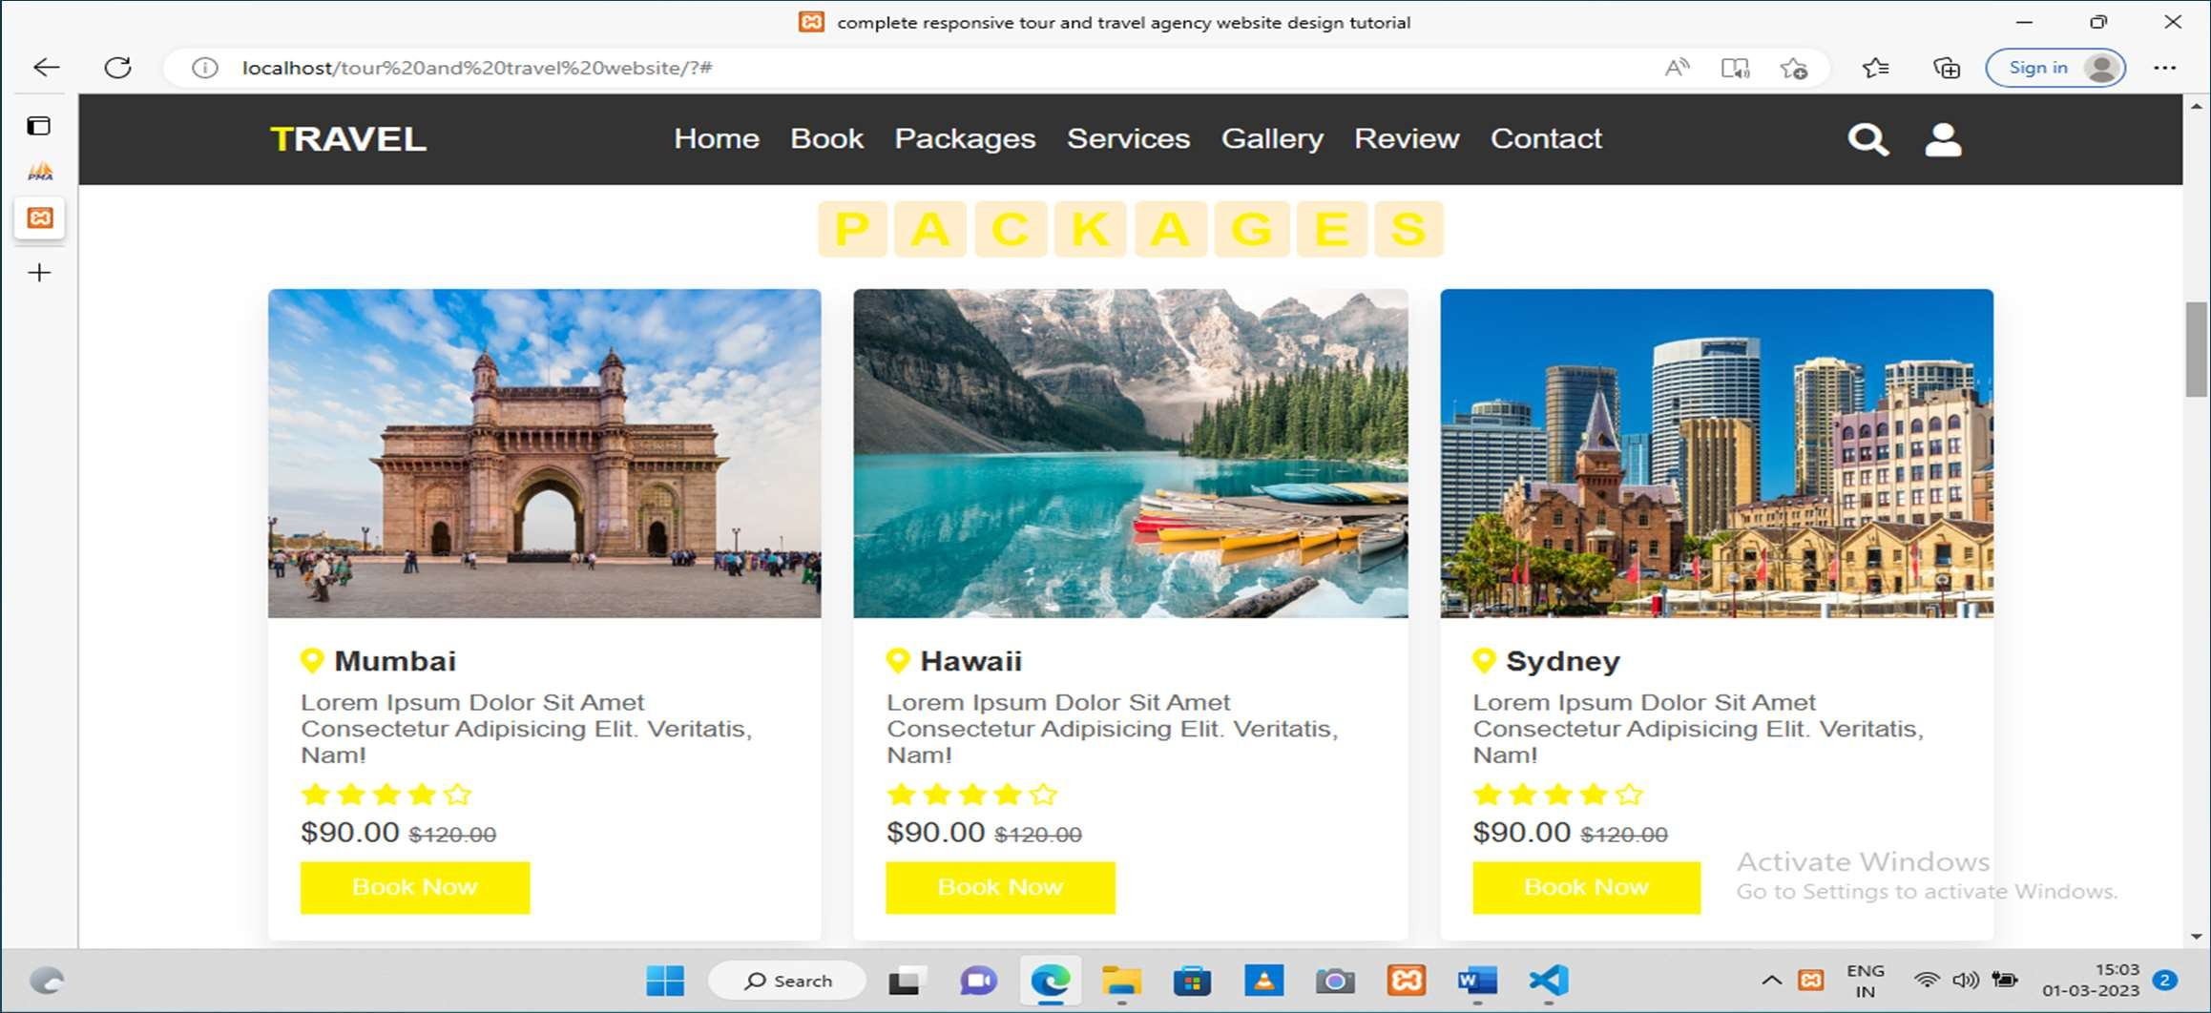

Slide 35
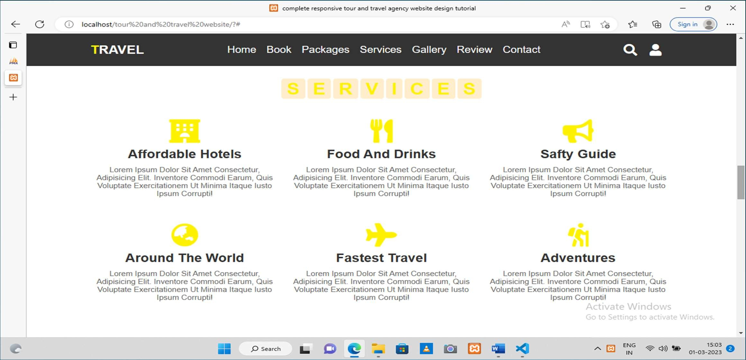

Slide 36
Testing and Implementation
Grey Box Testing
Grey Box testing is testing technique performed with limited information about the internal functionality of the system. Grey Box testers have access to the detailed design documents along with information about requirements.
Grey Box tests are generated based on the state-based models, UML Diagrams or architecture diagrams of the target system.
Black Box
White Box

Slide 37
Limitation of System
Online
You must have pc/laptop
Limited area covered
No Online Payment
Security

Slide 38
Future Enhancement
Nothing is perfect in this world. So, we are also no exception. Although, we have tried our best to present the information effectively, yet, there can be further enhancement in the Application.
We have taken care of all the critical aspects, which need to take care of during the development of the Project.
Like the things this project also has some limitations and can further be enhances by
Someone, because there are certain drawbacks that do not permit the system to be 100%

Slide 39
Bibliography
https://www.w3schools.com/
https://www.wikipedia.org/
https://www.google.com/

Slide 40
Thank You..!

